Slide 1
IT-331 ( Computer Graphics 1)
Lecture 9
Two-Dimensional Viewing Pipeline
Line Clipping
Dr. Mohammed El-Said
Assistant Professor, Computer Science Dept.,
Faculty of Computers & Artificial Intelligence,
Helwan University - Cairo, Egypt.

Slide 2
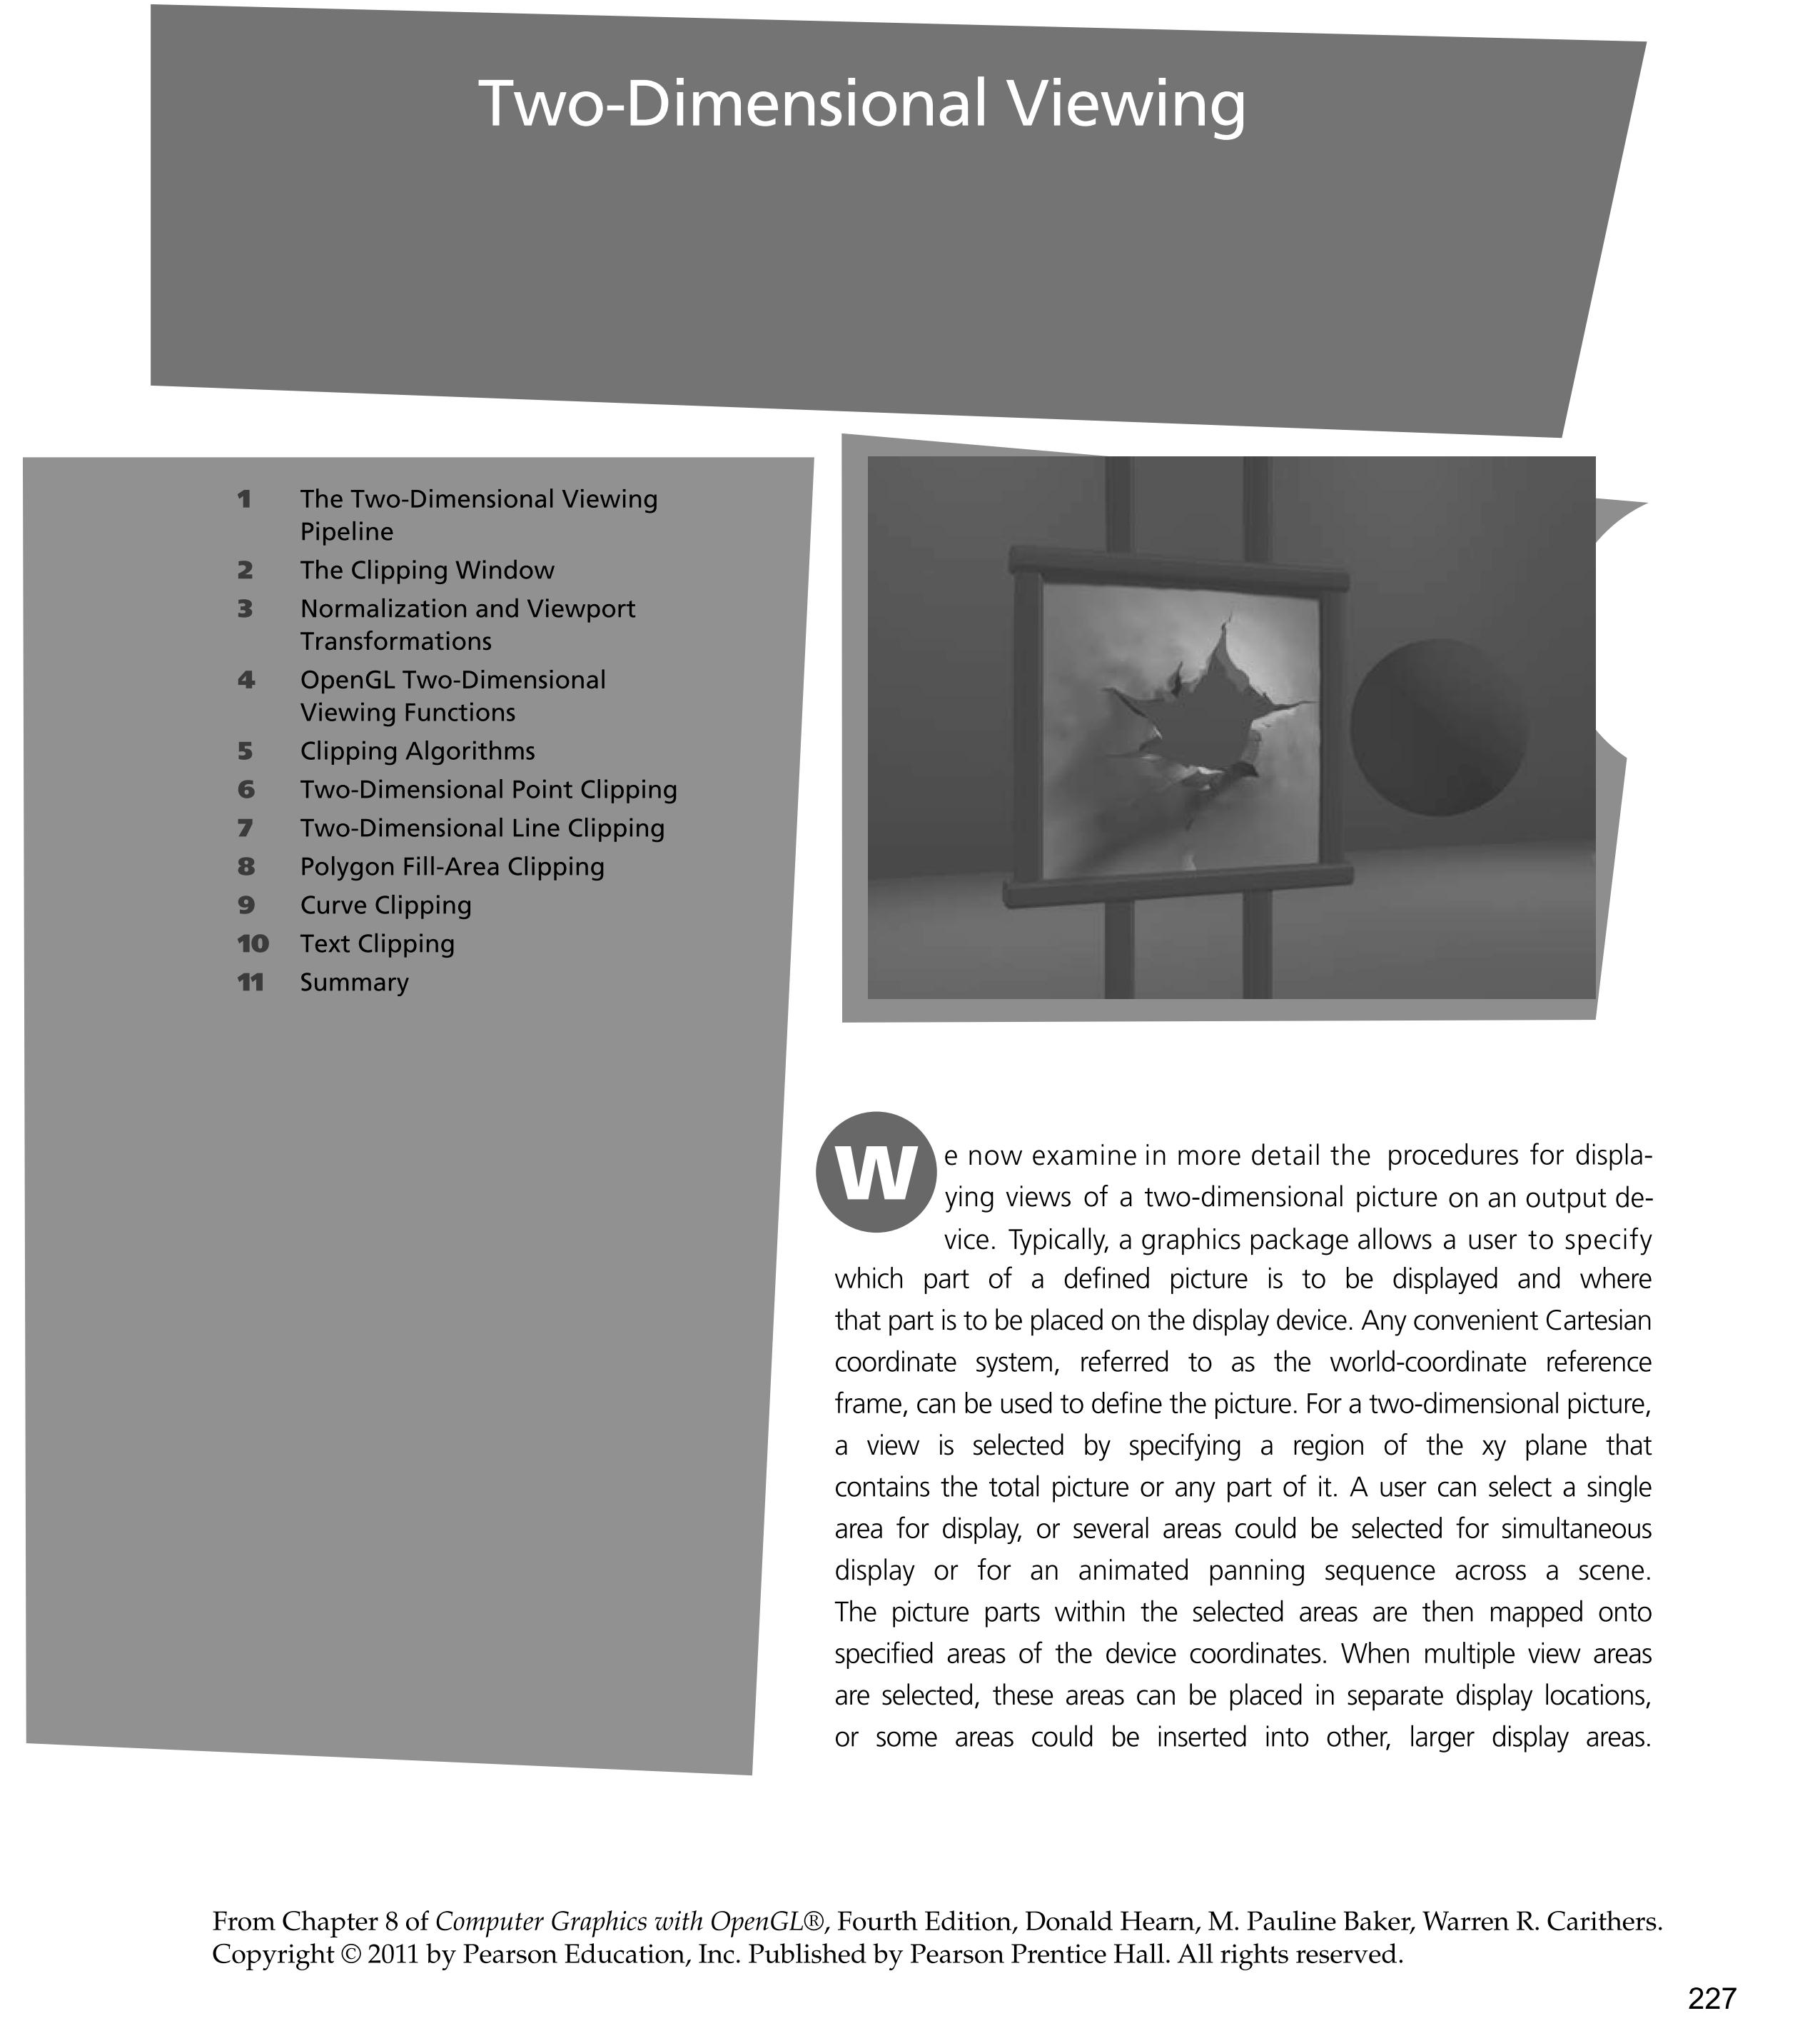

Slide 3
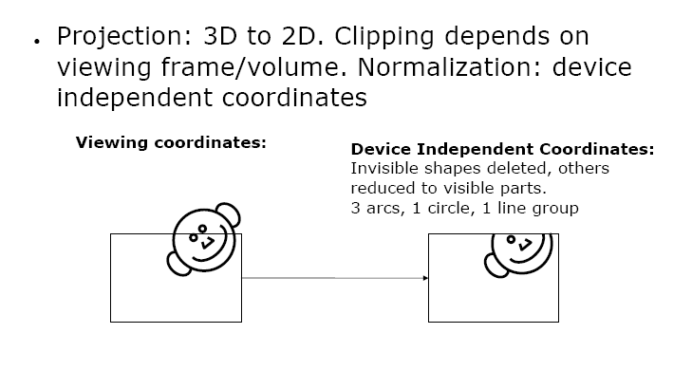

Slide 4
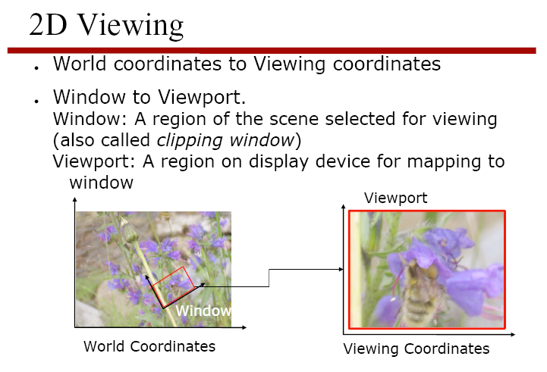
Graphics packages commonly allow only rectangular clipping windows aligned with the x- and y-axes
Must implement own clipping and coordinate transformations for other form of clipping

Slide 7
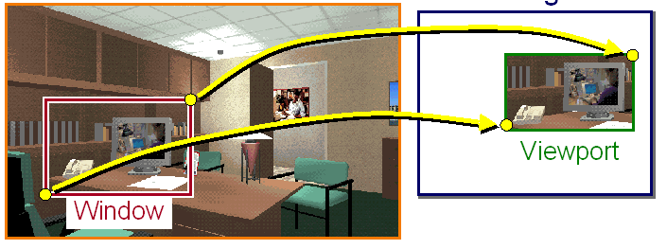

Slide 8
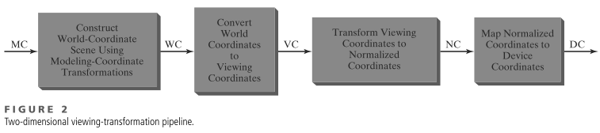

Slide 9
(clipping) window to viewport transformation
Zooming
is successive mapping of different sized clipping windows to the viewport
reducing clip window : zoom in on part of scene
increase clip window : zoom out
Panning
moving a fixed-size clipping window across the scene

Slide 10
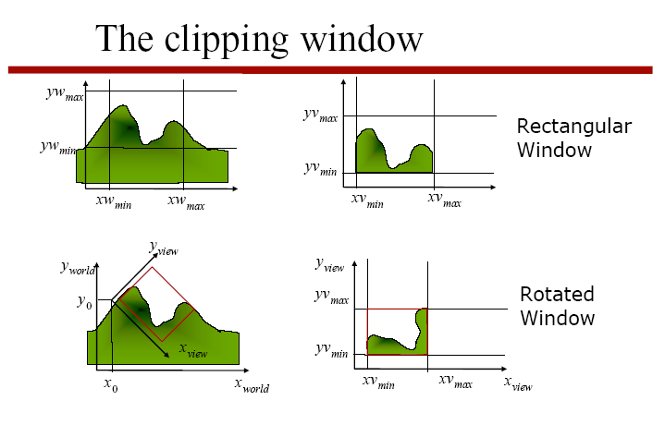
From world coordinates to view coordinates

Slide 11
Clipping
Remove portion of output primitives outside clipping window
May require more complex geometry than rectangular boxes

Slide 12
Two-Dimensional Clipping
Point clipping – trivial
Line clipping
Cohen-Sutherland
Liang-Barsky
Nicholl-Lee-Nicholl
Polygon Fill-Area clipping
Sutherland-Hodgeman
Weiler-Atherton

Slide 13
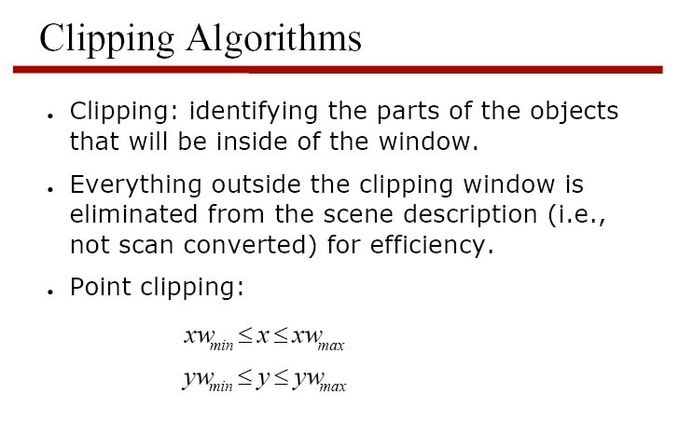
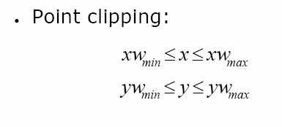

Slide 14
Cohen-Sutherland
Clip line against each edge of clip region in turn
If both endpoints outside, discard line and stop
If both endpoints in, continue to next edge (or finish)
If one in, one out, chop line at crossing pt and continue

Slide 15
Cohen-Sutherland
1
2
3
3
4
4
3
3
4
4
1
2
1
2

Slide 16
Cohen-Sutherland
Some cases lead to early acceptance or rejection
If both endpoints are inside all edges
If both endpoints are outside one edge

Slide 17
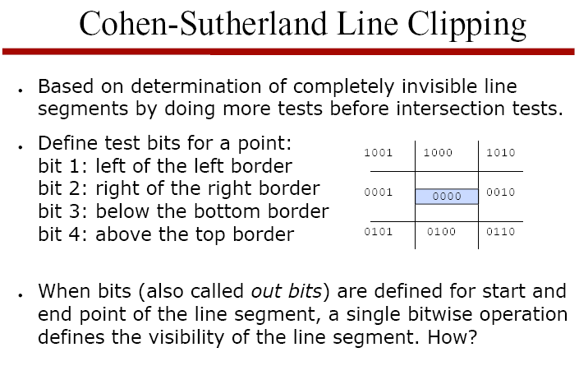
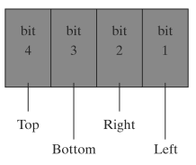

Slide 18
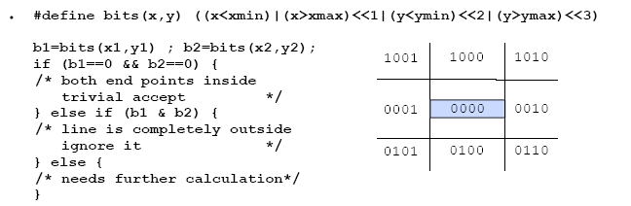
b1 OR b2 = 0 iff both end points inside clipping window. Accept
b1 AND b2 ≠ 0 iff line end points are in the same half-space defined by an edge of the clipping window. Reject
Else subdivide the line into two segments at the point where it crosses a clipping rectangle edge. Reject segment(s) outside the clipping edge

Slide 19
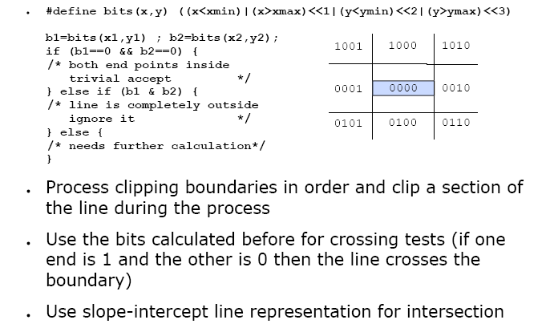

Slide 20
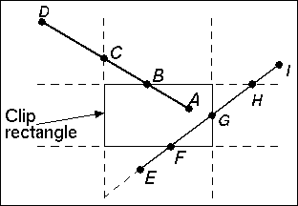
The Cohen-Sutherland algorithm
Consider line AD (above). Point A has outcode 0000 and point D has outcode 1001. The line AD cannot be trivially accepted or rejected. D is chosen as the outside point. Its outcode shows that the line cuts the top and left edges (The bits for these edges are different in the two outcodes). Let the order in which the algorithm tests edges be top-to-bottom, left-to-right. The top edge is tested first, and line AD is split into lines DB and BA. Line BA is trivially accepted (both A and B have outcodes of 0000). Line DB is in the outside halfspace of the top edge, and gets rejected.

Slide 21
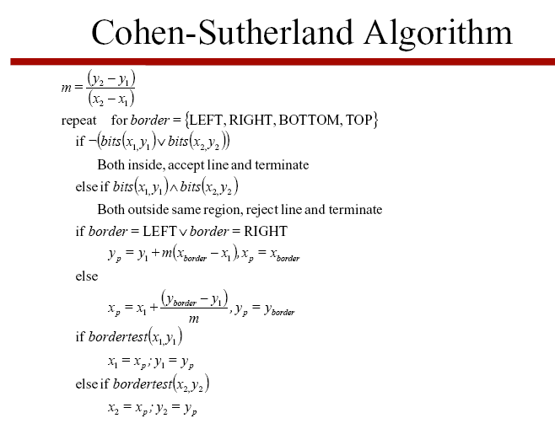
update line endpoint coordinates

Slide 22
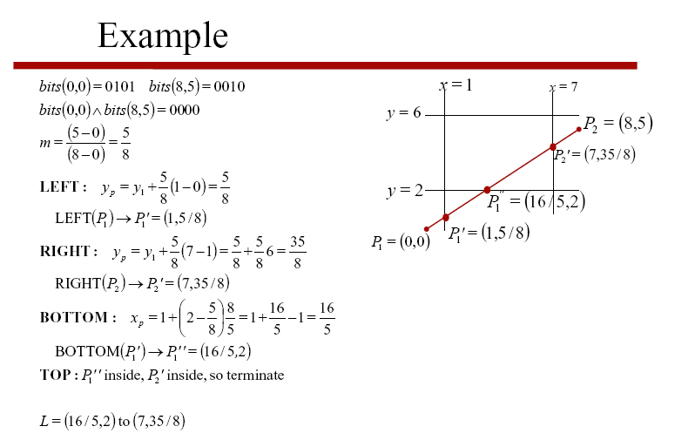

Slide 23
Cohen-Sutherland Line Clipping
Fixed order testing and clipping cause needless clipping (external intersections)
Extra clipping here

Slide 24
Cohen-Sutherland Line Clipping
This algorithm can be very efficient if it can accept and reject primitives trivially
If clip window is large wrt scene data
Most primitives are accepted trivially
If clip window is much smaller than scene data
Most primitives are rejected trivially
Good for hardware implementation

Slide 25
Nicholl-Lee-Nicholl Line Clipping
Creates more testing regions around the clipping window
Avoids multiple line-intersection calculations
Initial testing to determine if a line segment is completely inside the clipping window can be done using previous methods
If trivial acceptance or rejection is not possible the NLN algorithm sets up additional regions

Slide 26
P0
P0
P0
For line with endpoints P0Pend, there are three different positions to consider - all others can be derived from these by symmetry considerations
For each case, we generate specialized test regions for other endpoint Pend, which use simple tests (slope, >, <), and tells us which edges to clip against.

Slide 27
Case 1
T
Find which of the four regions Pend lies in, then calculate the line intersection with the corresponding boundary
L
R
P0
B

Slide 28
Case 2
LT
L
P0
L
LR
L
LB
Find which of the four regions Pend lies in, then calculate the line intersection with the corresponding boundary

Slide 29
Case 3 : 2 possibilities
P0
P0
T
T
TR
L
T
TR
L
L
LR
LB
TB
LB
Find which of the five regions Pend lies in, then calculate the line intersection with the corresponding boundary

Slide 30
N-L-N Line clipping
To determine in which region Pend lies we compare the slope of PendPo to the slopes of the boundaries of the NLN regions
LT
L
P0
L
LR
L
LB
Number of cases explodes in 3D, making algorithm unsuitable

